Slide 1
NLP Classifiers: Subreddits
DSI -11 -San Francisco Alicia Rodriguez

Slide 2
Agenda
Data Collection
Data Cleaning
Pre-processing
Modeling
Evaluation of the Model
Conclusions and Next Steps

Slide 3

Problem Statement
Get 2 web APIs from Reddit.com using NLP to make a binary classification and predict which post is in each subreddit.

Slide 4


Subreddits
Streaming
-Members: 16,000
-Content: For those interested in and active in streaming.
-Original numbers of rows: 2666
Startups
--Members: 426,000
-Content: For those who want to discuss startup problems and solutions.
-Original number of rows: 2066

Slide 5
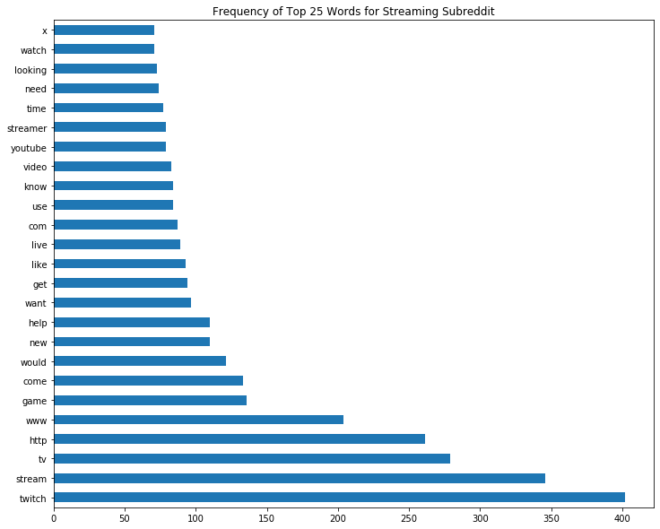
Words Frequency Streaming Subreddit

Slide 6
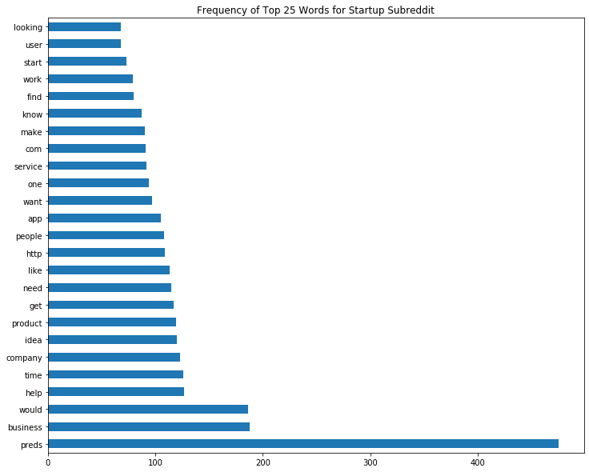
Words Frequency Startup Subreddit

Slide 7


Subreddit Class
Streaming Startup

Slide 8
Data Cleaning
Duplicates by authors were removed -Streaming: 1409 rows
-Startup: 1314 rows
Removed: -HTML format
-Non-letter items ex: punctuation
-Unnecessary words ex: “removed”

Slide 9
Preprocessing
Combined dataframes
Columns chosen: Title and Selftext
Applied the Lemma -tokenizer to all models
Parameters taken into account: - N grams (1, 1) and(1, 2)
-Max Features : 100, 250, 500, 1000
-Stop words: ‘None’ and ‘English’

Slide 10
Model Selection
Did GridsearchCV with 3 CV + hyper parameters to choose the best model.
Created pipelines and did a train, test - split to evaluate the models. Count
Models:
1)Vectorizer -Linear Regression
2)TFIDF - Linear Regression
3)Count Vectorizer - Multinomial Naive Bayes
4)TFIDF - Gaussian Naive Bayes

Slide 11
Accuracy Results of the Models
Subreddits Baseline
Score: “0” = 0.50 “1” = 0.49
Models | Train Score | Test Score
Count Vec -Linear Reg | 0.989 | 0.945
TFIDF - Linear Reg | 0.978 | 0.934
Count Vec - Multinomial NB | 0.952 | 0.939
TFIDF - Gaussian NB | 0.972 | 0.936

Slide 12
Best model: Count Vectorizer with Multinomial Naive Bayes
Confusion Matrix
Type I: False Positive = 21
Type II: False Negative = 33
 | Predict Negative | Predict Positive
Actual Negative | 444 | 21
Actual Positive | 33 | 401

Slide 13
Confusion Matrix Metrics
Accuracy | 94.8%
Misclassification | 5.2%
Sensitivity | 93.6%
Specificity | 95.9%
Precision | 95.6%

Slide 14
Higher Presence of words (coefficient)
Streaming
Startup
Stream
Twitch
TV
Live
You Tube
Facebook
Webcam
Gaming
Business
Idea
Team
Product
Founder
Marketing
Project
Apps

Slide 15
Conclusions and Recommendations
The best model was the countvectorizer with Multi-binomial Naive Bayes.
Explore other models: Random Forest.
Analyze more stop words.
Analyze the words that appear the most in each subreddit and see the opportunities to focus or research on to elaborate strategies.
Check the words with the coefficients per subreddit to discover unique words and differentiators.

Slide 16
Thank you

